Slide 1
Team 3
Bank Loan Case Study
Dinan Sooriyaarachchi, Louisa Anjanette Auwlia, Benjamin Tran, Brandon Tang, Amelie Carrillo, Keira Sakamoto

Slide 2
Overview
01.
02.
03.
04.
05.
Data Cleaning
Exploratory Analysis
Logistic Regression Model
Cost Benefit Analysis
Interpretation, Recommendation

Slide 3
01.
Data Cleaning

Slide 4
Data Cleaning Timeline
Applied Binary Encoding to Categorical Columns: Converted RevLineCr, LowDoc, and UrbanRural into binary (1 or 0) values for machine learning compatibility.
Output: One-hot encoded categorical columns.
Dropped Rows with Missing Values: Removed rows with missing values in critical columns like State, BankState, NewExist, RevLineCr, LowDoc, DisbursementDate, and MIS_Status.
Dropped Irrelevant Columns: Removed columns that were not necessary for the analysis, such as LoanNr_ChkDgt, Name, Bank, City, Zip, CreateJob, and RetainedJob.
Dropped Duplicate Rows: Identified and removed duplicate rows to maintain data uniqueness.
Removed Foreign Values: Removed values in columns that had values that didn’t match with what was supposed to be there (e.g. removing values like ‘a’ from column where valid values are only 0 and 1)
Applied One-Hot Encoding to NAICS Column:
Transformed NAICS into one-hot encoded columns to represent industry categories numerically.

Slide 5
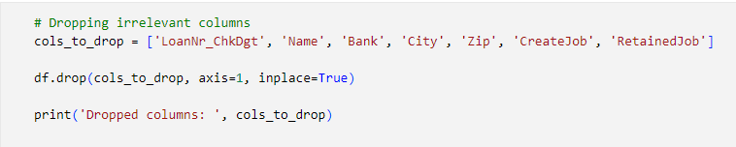
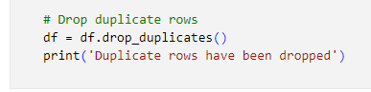
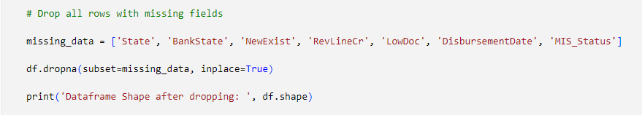
Data Cleaning
Notes:
LoanNr_ChkDgt =Loan Number Check Digit

Slide 6
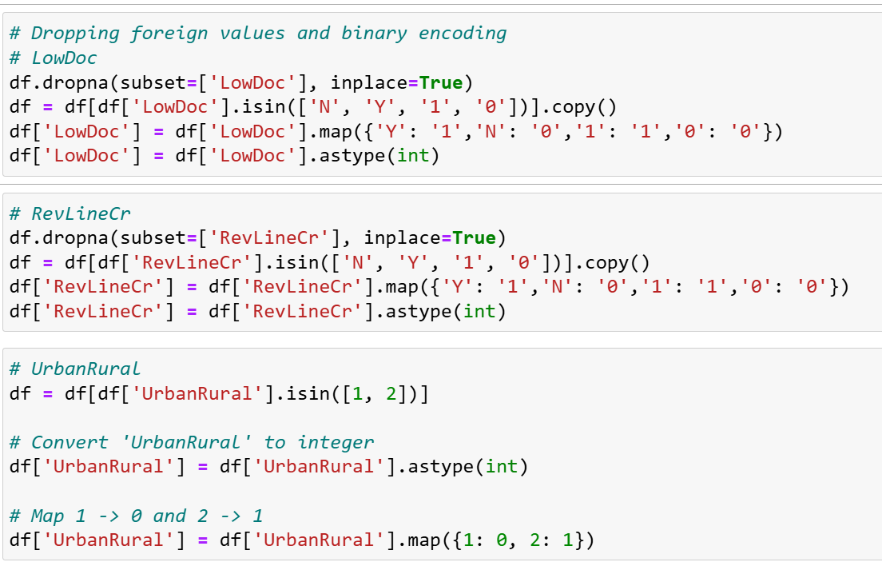
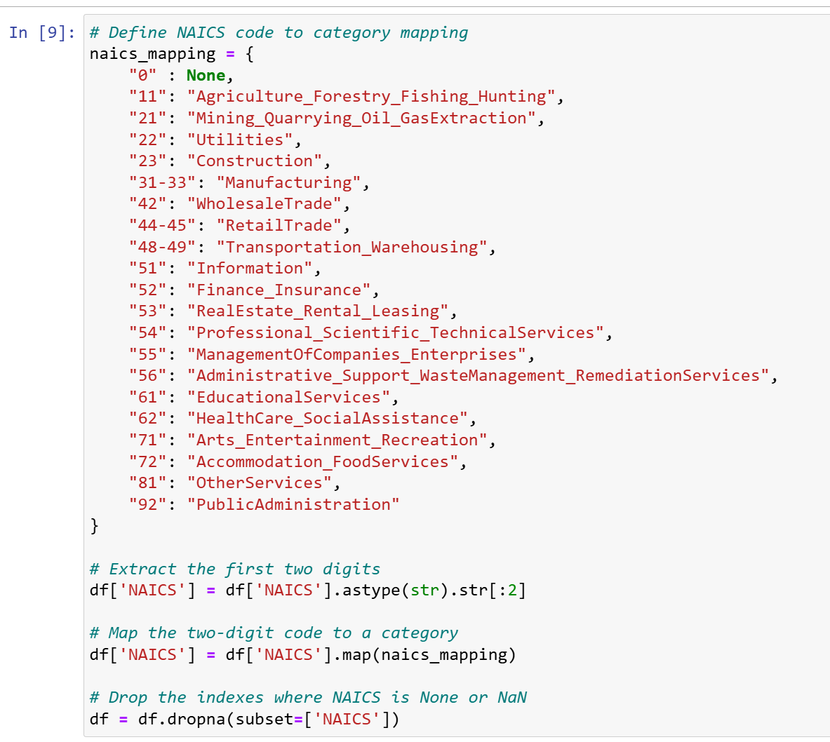
Data Cleaning
Notes:
Ensuring that all values in these rows are either 0 or 1, by changing valid values into 0s and 1s, and then removing everything else
Codes for NAICS show the industry that the company was from,

Slide 7
02.
Exploratory Analysis

Slide 8
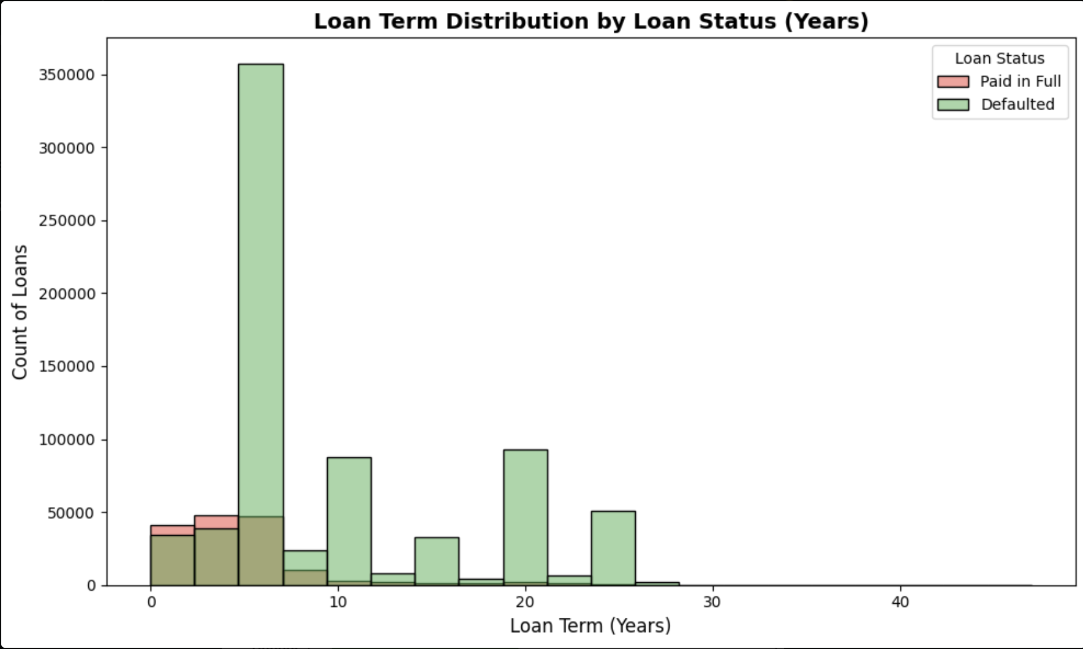
Visualizations
By creating the “Term_Years” column which was derived from the “Term” column, we converted loan terms from months to years for easier interpretation. This histogram shows how loan terms relate to loan status (Paid in Full vs. Defaulted). This reveals trends like shorter-term loans being more likely to be repaid, while longer terms might show higher default rates.
Notes:
Overlapping between paid in full and defaulting between 0 and 10 years

Slide 9
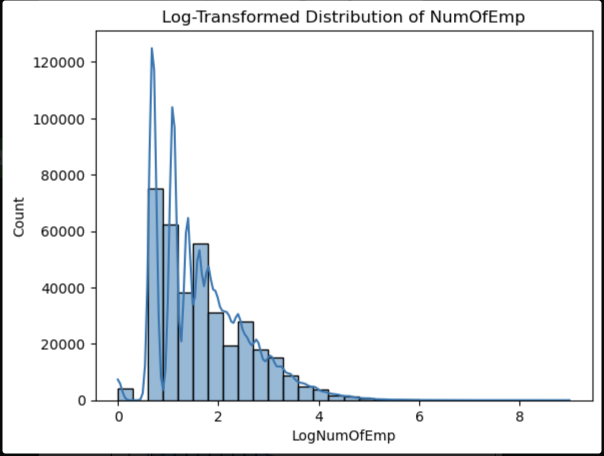
Visualization
By log-transforming the “NumOfEmp” we are able to see that the majority of businesses have a small number of employees, as indicated by the high frequency near lower log values, while fewer businesses have larger workforces. The log transformation smooths the data, making the distribution easier to interpret.

Slide 10
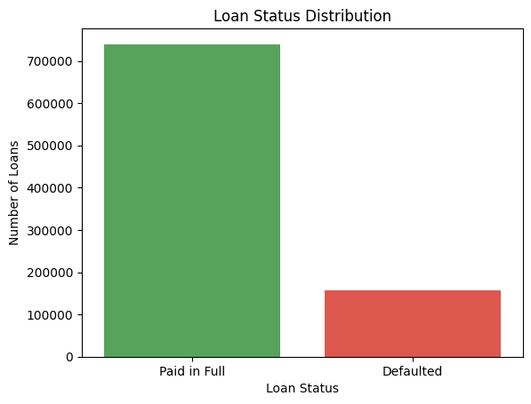
Visualization
Shows the distribution of loan statuses. The green bar represents loans that were "Paid in Full," which are significantly higher in number compared to the red bar, representing "Defaulted" loans. This imbalance highlights the need to address the class imbalance in the dataset, as it could impact the performance of the predictive model.

Slide 11
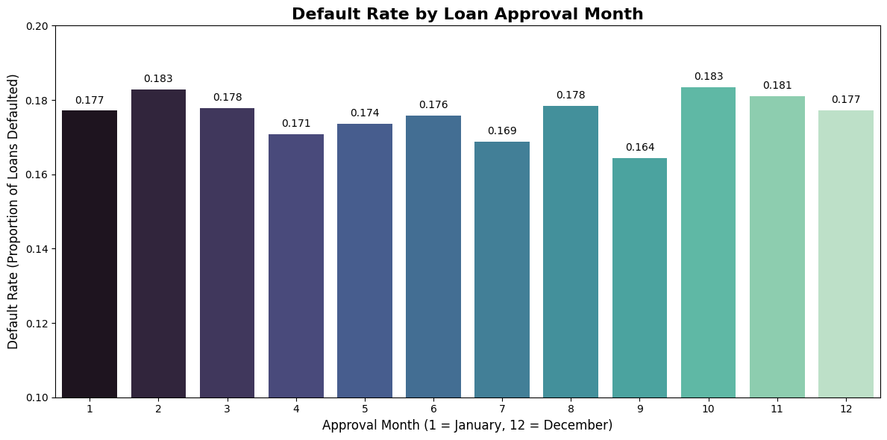
Visualization
The graph shows default rates across loan approval months, with the lowest in September (0.164) and the highest in February and October (0.183). Most months have similar default rates around 0.176–0.183, indicating consistent patterns except for seasonal variations. Lenders should investigate higher default months to adjust approval strategies, while borrowers perform better with loans approved in September.
Notes:
Month was extracted by Approval Date df['month'] = df['ApprovalDate'].str.split('-').str[1]
Mean was found by grouping MIS_Status: default_by_month = df.groupby('ApprovalMonth')['MIS_Status_Numeric'].mean()

Slide 12
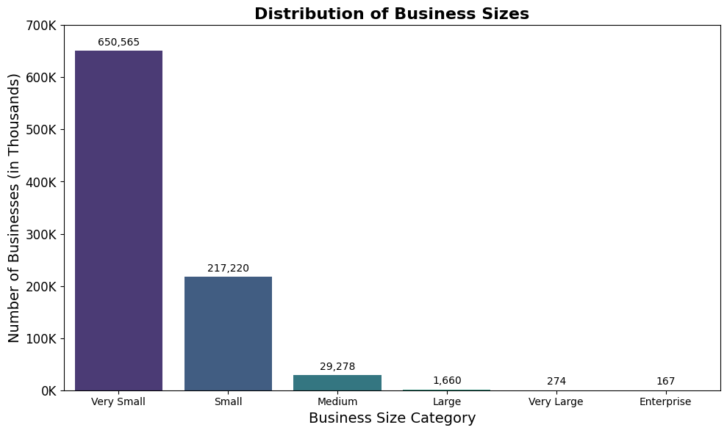
Visualization
The graph depicts the distribution of businesses by size categories. “Very Small" businesses dominate the dataset, comprising 650,565 entities, followed by "Small" businesses at 217,220. In contrast, larger categories such as "Medium" (29,278), "Large" (1,660), "Very Large" (274), and "Enterprise" (167) have significantly fewer businesses, emphasizing the predominance of smaller enterprises in the dataset.
Notes:
Self-explanatory

Slide 13
03.
Logistic Regression Model

Slide 14
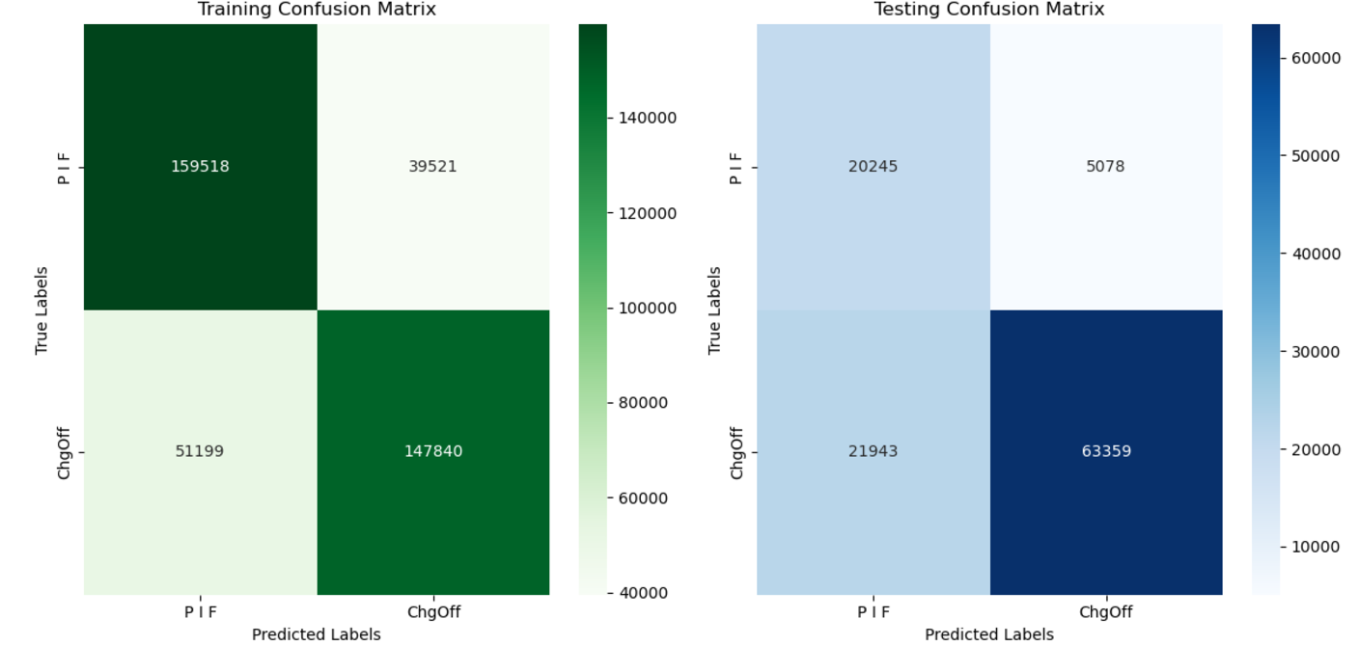
Confusion Matrix
Notes:
X variables: DisbursementGross, Term, Loantoapproval ratio, num or emp, NAICS -> dummy variables
Y MIS_Status
Used SMOTE to address the imbalance between the MIS_Status
MIS_Status
1 284341
0 84409

Slide 15
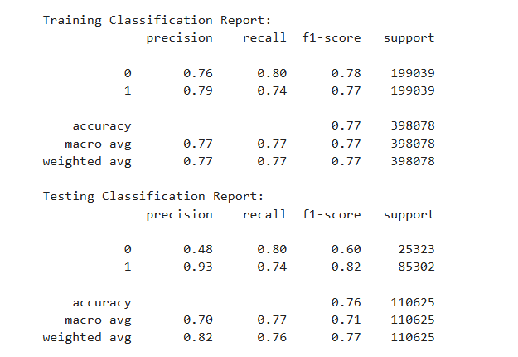
Classification Report
Notes:
Testing vs Training:
Testing did a lot worse in predicting defaults (0) compared to testing but a lot better in predicting non-defaults (1)
Overall accuracy of testing was slightly lower than the training accuracy, which is expected due to test data variability.
Precision: actual positives divided by positive predictions
Recall: actual positives divided by real positives

Slide 16
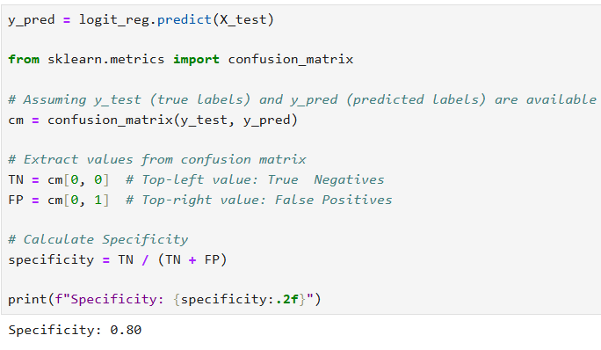

Specificity
True Negatives (TN): Loans predicted as "No Default/PIF" that truly didn't default.
False Positives (FP): Loans predicted as "No Default/PIF" but actually defaulted.

Slide 17
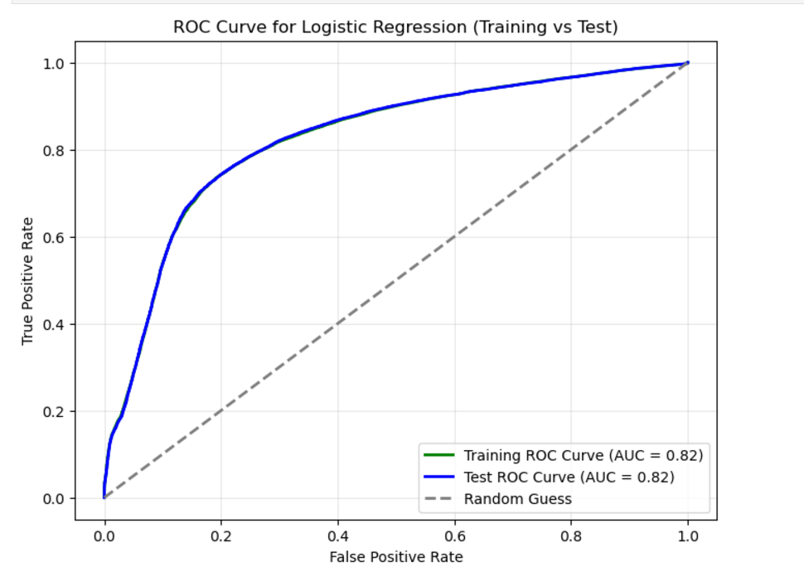
ROC Curve
Notes:
Model Performance:
The curve is significantly above the dashed line, showing the model can effectively distinguish between "PIF" and "ChgOff."
An AUC of 0.82 suggests a strong model, though there is room for improvement.
indicates that the model distinguishes effectively between risky and non-risky borrowers, significantly outperforming random guessing (AUC = 0.5).
Threshold Trade-Off:
At lower thresholds (right side of the curve), the model predicts more cases as positive, leading to a higher TPR but also a higher FPR.
At higher thresholds (left side of the curve), the model is stricter, leading to a lower FPR but also potentially missing some positive cases (lower TPR).
Possibly overfitting, identical datasets which led to the same AUC

Slide 18
04.
Cost Benefit Analysis

Slide 19
Cost-Benefit Analysis
Costs
False Positives 5078 (4%) loans misclassified as defaults
- May lead to unnecessarily stringent loan terms or rejections for loans that would have been profitable
- Opportunity cost of losing potential revenue from low-risk borrowers
False Negatives 21,943 (20%) loans misclassified as non-defaults
- These loans pose significant financial risk, as they represent defaults the model failed to identify
- Could lead to increased loan loss reserves and harm the institution’s financial stability
Imbalanced Precision
- Lower precision for non-defaults suggests that improving the model’s ability to differentiate non-defaulted loans is critical to avoiding unnecessary costs from misclassified loans
Benefits
Reduction in Risk
- High precision for defaults (0.93) minimizes the risk of approving high-risk loans
- By identifying 74% of true defaults (recall), the model provides reliable insights to reduce defaulted loan rates
Improved Lending Strategy
- Correctly predicting defaults effectively allows lenders to tailor loan terms, request additional collateral, or deny high-risk applications outright, ensuring profitability and reduced write-offs
Notes:
110,625 total rows for testing

Slide 20
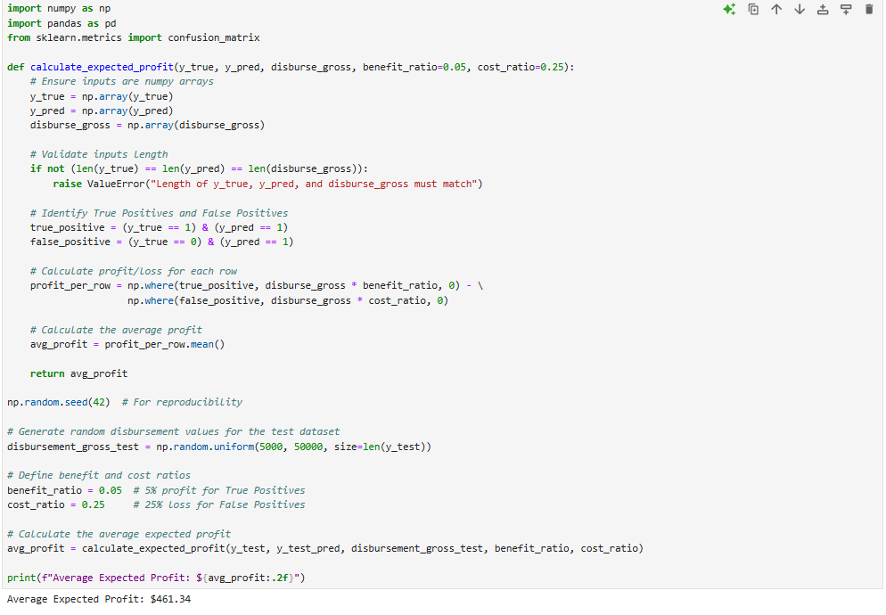
Cost Benefit Analysis

Slide 21
Interpretations
Our model prioritizes minimizing false positives over minimizing false negatives because it is more costly to give out a loan to a company that is going to default versus not giving out a loan to a company that is going to pay the loan back fully
Our cost benefit analysis shows us that the bank makes an average of $461 per loan, which seems low, but makes sense because the risk of losing is 5 times as bad as correctly classifying a loan
In a real life scenario, bank employees will use this model to decide whether to give out a loan or not.
As time passes, more data points can be added to the dataset periodically to keep the model updated and to see if changes need to be made to improve the model

Slide 22
Thanks!

